Slide 1
Introduction to Computer Simulation of Physical Systems
(Lecture 5)
Simulating Particle Motion (CONTINUED)
PHYS 3061

Slide 2
computation of the accelerations of the particles.
  The most time consuming part of MD.
The method computeAcceleration determines the total force on each particle
  due to the other N −1 particles
  uses Newton’s third law to reduce the number of calculations by a factor of two.

Slide 3
For a system of N particles, there are a total of N(N −1)/2 possible interactions.
Because of the short range nature of the Lennard-Jones potential, we could truncate the force at r = rc and ignore the forces from particles whose separation is greater than rc.
However, for N < 400, it is easier to include all possible interactions, no matter how small.

Slide 4
The quantity virial accumulated in computeAcceleration will be discussed later,
  We will see that it is related to the pressure.
  It is convenient to also calculate the potential energy in computeAcceleration.
  Note that in reduced units, the mass of a particle is unity, and hence the acceleration and force are equivalent.

Slide 5
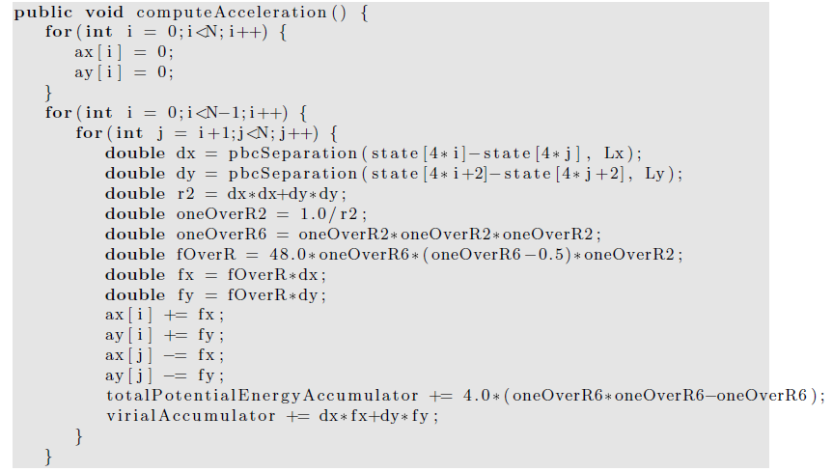
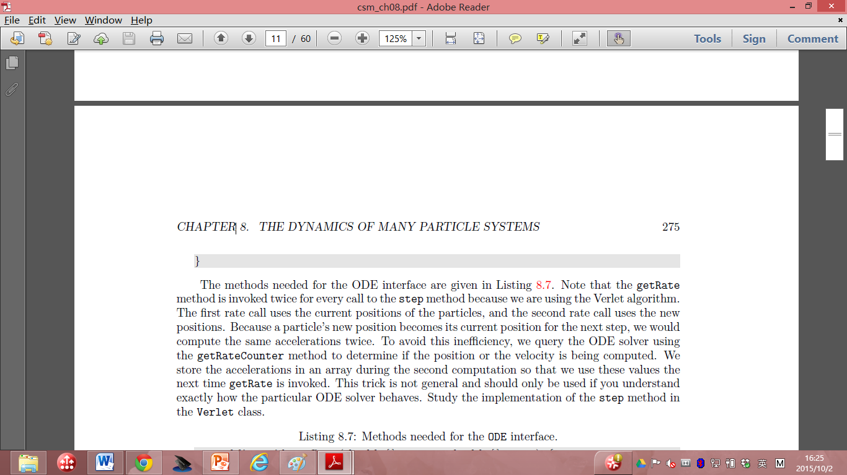

Slide 6
The methods needed for the ODE interface are given in next few pages.
Note that the getRate method is invoked twice for every call to the step method because we are using the Verlet algorithm.
The first rate call uses the current positions of the particles, and the second rate call uses the new positions.

Slide 7
Because a particle’s new position becomes its current position for the next step, we would compute the same accelerations twice in Verlet.
Any solutions?

Slide 8
To avoid this inefficiency, we query the ODE solver using the getRateCounter method to determine if the position or the velocity is being computed.
We store the accelerations in an array during the second computation so that we use these values the next time getRate is invoked.
This trick is not general and should only be used if you understand exactly how the particular ODE solver behaves.

Slide 9
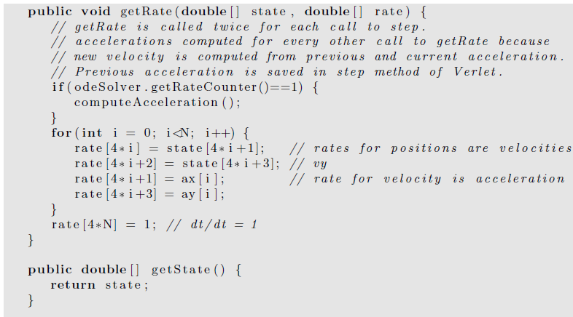

Slide 10
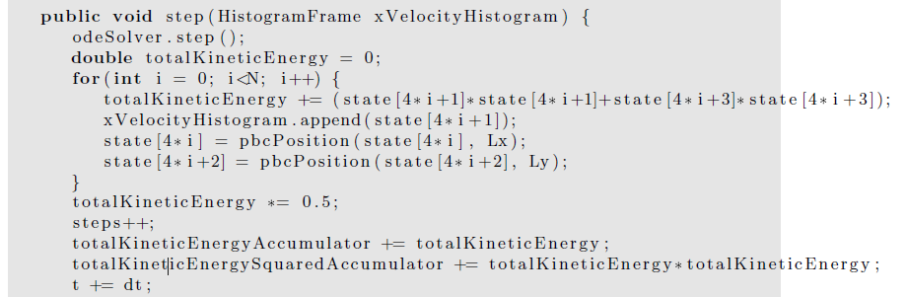
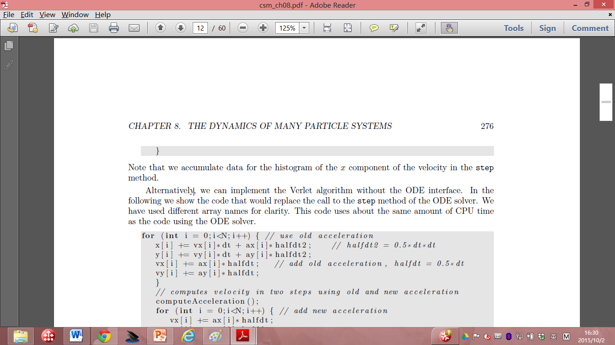

Slide 11
Note that we accumulate data for the histogram of the x component of the velocity in the step method.
Alternatively, we can implement the Verlet algorithm without the ODE interface.
In the following we show the code that would replace the call to the step method of the ODE solver.
We have used different array names for clarity.
This code uses about the same amount of CPU time as the code using the ODE solver.

Slide 12
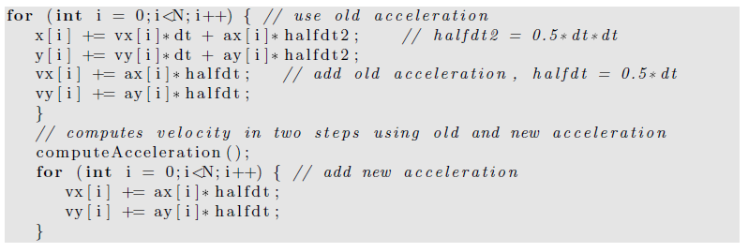
In next page, we give some of the methods for computing the temperature, pressure (details will be covered later), and the heat capacity (also covered later).
The mean total energy should remain constant, but we compute it to test how well the algorithm conserves the total energy.

Slide 13
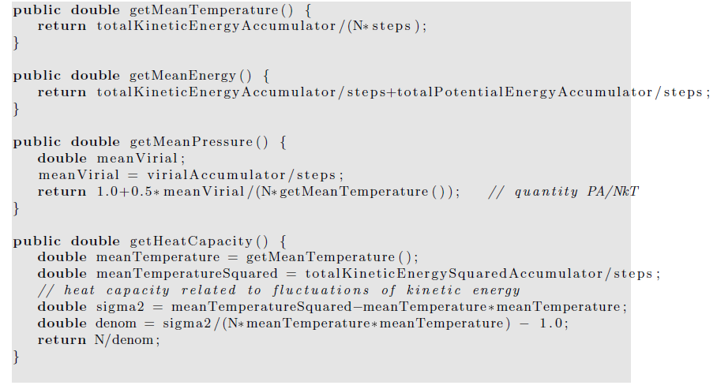

Slide 14
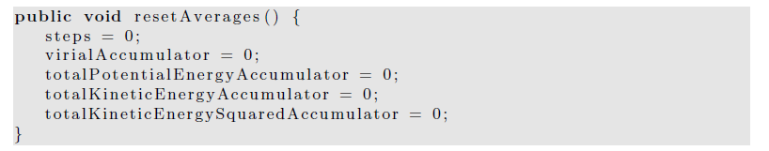
The resetAverages method is used to set the accumulated averages to zero so that the initial transient behavior can be removed from the computed averages.

Slide 15
a time consuming part of a molecular dynamics simulation is equilibrating the system, especially at high densities.
The quickest way to do so is to start with a configuration that is typical of the configurations at the desired energy and density.

Slide 16
Hence, we will want to be able to read the positions and velocities of the particles from a previously saved file.
For the GUI code, please read the text book if you are interested.

Slide 17
Thermodynamic Quantities
In the following we discuss how some of the macroscopic quantities of interest such as the temperature and the pressure can be related to time averages over the phase space trajectories of the particles.

Slide 18
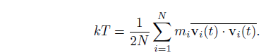
We have already introduced the definition of the kinetic temperature.
The temperature that we measure in a laboratory experiment is the mean temperature, which corresponds to the time average of T(t) over many configurations of the particles.
For two dimensions (d = 2), we write the mean temperature T as

Slide 19
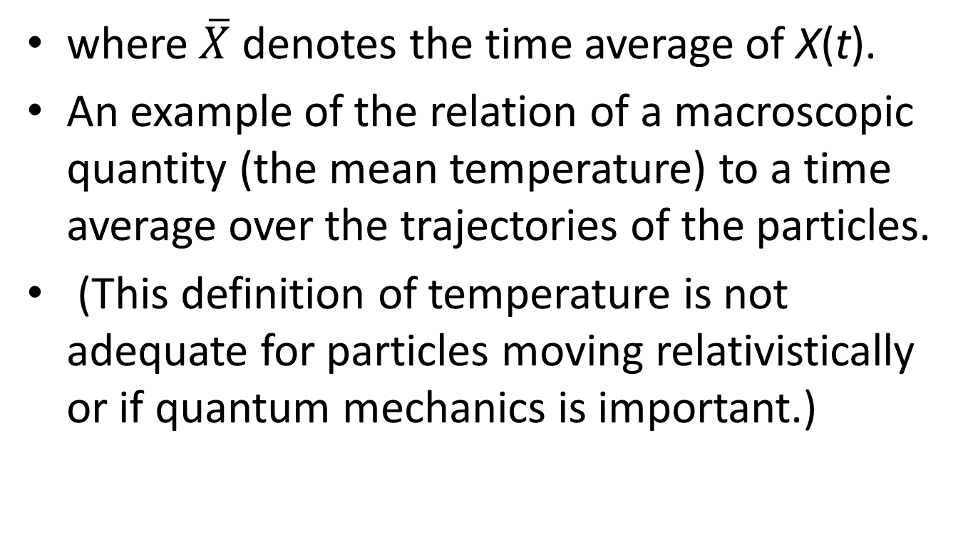
where $\overline{X}$ denotes the time average of X(t).
An example of the relation of a macroscopic quantity (the mean temperature) to a time average over the trajectories of the particles.
(This definition of temperature is not adequate for particles moving relativistically or if quantum mechanics is important.)

Slide 20
The relation holds
  only if the momentum of the center of mass of the system is zero!
we do not want the motion of the center of mass to change the temperature.
In a laboratory system the walls of the container ensure that the center of mass motion is zero

Slide 21
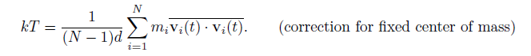
(if the mean momentum of the walls is zero).
In our simulation, we impose the constraint that the center of mass momentum (in each of the d directions) be zero.
Consequently, the system has dN − d independent velocity components rather than dN components, and we should replace the equation by

Slide 22
The presence of the factor (N −1)d rather than Nd is an example of a finite size correction that becomes unimportant for large N.
Another macroscopic quantity of interest is the mean pressure.
The pressure is related to the force per unit area normal to an imaginary surface in the system.
By Newton’s second law, this force is related to the momentum that crosses the surface per unit time.

Slide 23
We could use this relation to determine the pressure, but this relation uses information only from the fraction of particles that are crossing an arbitrary surface at a given time.
Instead, we will use the relation of the pressure to the virial , which involves all the particles in the system.

Slide 24
In general, the momentum flux across a surface has two contributions.
The contribution, NkT/V , where V is the volume (area) of the system, is due to the motion of the particles and is derived in many texts using simple kinetic theory arguments.

Slide 25
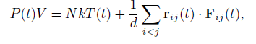
The other contribution to the momentum flux arises from the momentum transferred across the surface due to the forces between particles on different sides of the surface.
It can be shown that the instantaneous pressure at time t including both contributions to the momentum flux is given by

Slide 26
where r_{ij} = r_{i} − r_{j} and F_{ij} is the force on particle i due to particle j.
The second term is related to the virial and represents the correction to the ideal gas equation of state due to the interactions between the particles.
  (In two and one dimensions, we replace V by the area and length, respectively.)
  Virial theorem is an important theory on the relation between average kinetic energy and virial of stable systems, proposed by Rudolf Clausius
    For detailed description: https://en.wikipedia.org/wiki/Virial_theorem

Slide 27
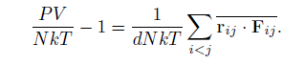
The mean pressure, P = P(t), is found by computing the time average of the right-hand side of the above equation.
The computed quantity is not P, but the ratio

Slide 28
The relation of information
  at the microscopic level to macroscopic quantities
  such as: the temperature and pressure
  one of the fundamental results of statistical mechanics.
In brief, molecular dynamics
  allows us to compute various time averages of the trajectory
    in phase space over finite time intervals.

Slide 29
One practical question:
  whether our time intervals are sufficiently long to allow the system to explore phase space and yield meaningful averages?
Calculations in statistical mechanics are done by replacing time averages by ensemble averages over all possible configurations.

Slide 30
The quasi-ergodic hypothesis asserts that these two types of averages give equivalent results if the same quantities are held fixed.
In statistical mechanics, the ensemble of systems at fixed E, V , and N is called the microcanonical ensemble.

Slide 31
Averages in this ensemble correspond to the time averages
  that we use in molecular dynamics
    at fixed E, V and N.
(Molecular dynamics also imposes an additional, but unimportant, constraint on the center of mass motion.)

Slide 32
Another useful thermal quantity is the heat capacity at constant volume,
  defined by the relation C_{V} = (∂E/∂T)_{V} .
  (The subscript V denotes that the partial derivative is taken with the volume held fixed.)
  C_{V} : an example of a linear response function
    the response of the temperature to a change in the energy of the system.

Slide 33
One way to obtain C_{V} is to determine T(E),
  the temperature as a function of E.
    (Remember that a molecular dynamics simulation yields T as a function of E.)
  The heat capacity is given approximately by ΔE/ΔT for two runs that have slightly different temperatures.
  This method is straightforward, but requires that simulations at different energies be done.

Slide 34

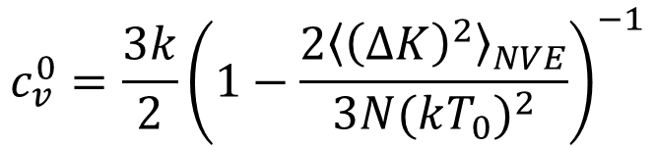
C_{V} is related to the fluctuations of the total energy in the canonical ensemble in which T, V , N are held fixed.
In molecular dynamics simulations
  (supposedly micro canonical ensemble),
  the total energy is fixed, but the kinetic and potential energies can fluctuate.
Another way of determining C_{V} is to relate it to the fluctuations of the kinetic energy. It can be shown that
$$c_{v}^{0}=\frac{3k}{2}{\left(1−\frac{2{\left\langle {\left(∆K\right)}^{2}\right\rangle }_{NVE}}{3N{(kT_{0})}^{2}}\right)}^{−1}$$

Slide 35
Radial Distribution Function
To gain more insight into the structure of a many body system
  looking at how the positions of the particles are correlated with one another due to their interactions.

Slide 36
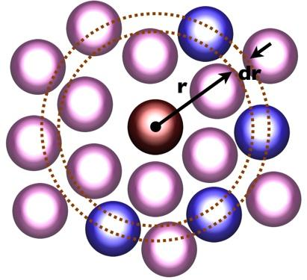
The radial distribution function g(r): a measure of this correlation and has the following properties:
  Suppose that N particles are in a region of volume V with number density ρ = N/V .
  Choose one of the particles to be the origin.
  Then the mean number of other particles between r and r + dr is defined to be ρg(r) dr.
  If the interparticle interaction is spherically symmetric and the system is a gas or a liquid, then g(r) depends only on the separation r = |r|.

Slide 37
The normalization condition for g(r) is
  ρ∫g(r) dr = N − 1 ≈ N,
  the volume element dr = 4πr²dr (d = 3), 2πrdr (d = 2), and 2dr (d = 1).
  if we choose one particle as the origin and count all the other particles in the system, we obtain N − 1 particles.
Question, what’s the g(r) for ideal gas?
  What’s the g(r) for LJ potential?

Slide 38
For an ideal gas, there are no correlations between the particles, and the normalization condition implies that g(r) = 1 for all r.
For the Lennard-Jones interaction, we expect that g(r) → 0 as r → 0,
  because the repulsive force between particles increases rapidly as r → ∞.
g(r) → 1 as r → ∞,
  because the correlation of a given particle with the other particles decreases as their separation increases.

Slide 39
Several thermodynamic properties can be obtained from g(r).
Because ρg(r) can be interpreted as the local density of particles about a given particle, the potential energy of interaction between this particle and all other particles between r and r + dr is u(r)ρg(r)dr,
  if we assume that only two-body interactions are present.

Slide 40
The total potential energy is found by integrating over all r and multiplying by N/2.
Why do we have to divide it with 2?

Slide 41
The result is that the mean potential energy per particle can be expressed as
U/N=(ρ/2) ∫g(r)u(r) dr.
It also can be shown that the relation for the mean pressure can be rewritten in terms of g(r) so that the equation of state can be expressed as
PV/NkT= 1 − (ρ/2kTd) ∫g(r) r (du(r)/dr)dr.

Slide 42
To determine g(r) for a particular configuration of particles,
  we first compute n(r,Δr), the number of particles in a spherical (circular) shell of radius r
  and a small, but nonzero width Δr,
    with the center of the shell centered about each particle.
  A method for computing n(r) is given in next page.

Slide 43
The use of periodic boundary conditions in computeRDF implies that
  the maximum separation between any two particles in the x and y direction is Lx/2 and Ly/2, respectively.
  Hence, we can determine g(r) only for r ≤ 1/2 min(Lx,Ly)

Slide 44
To obtain g(r) from n(r), we note that for a given particle i, we consider only those particles whose index j is greater than the index i (see computeRDF).
Hence, there are a total of 1/2N(N −1) separations that are considered.

Slide 45
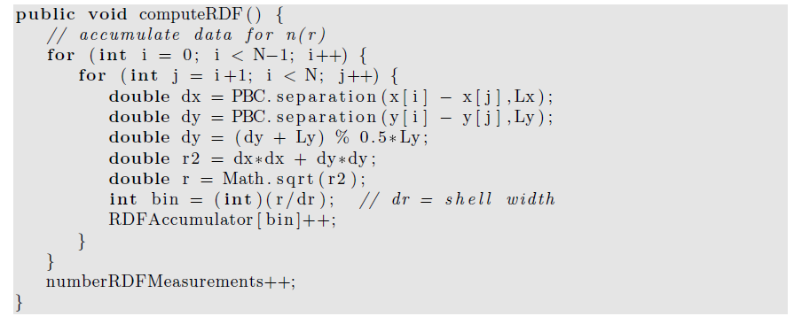
j

Slide 46
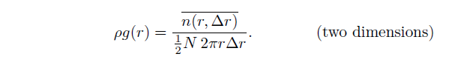
In two dimensions we compute n(r,Δr) for a circular shell whose area is 2πrΔr.
These considerations imply that g(r) is related to n(r) by
Note the factor of N/2 in the denominator. Method normalizeRDF normalizes the array
RDFAccumulator and yields g(r)

Slide 47
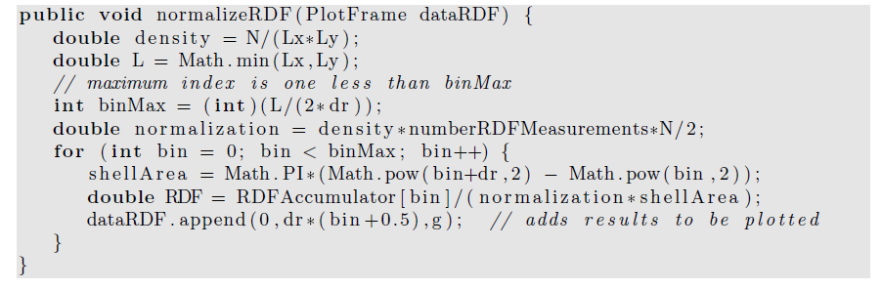
The shell thickness Δr needs to be sufficiently small so that the important features of g(r) are found, but large enough so that each bin has a reasonable number of contributions. The value of Δr should be a class variable. A reasonable choice for its magnitude is Δr = 0.025.

Slide 48
Dynamical Properties
The concept of a collision is not well-defined for systems with a continuous interaction such as the Lennard-Jones potential.
In the following, we take a more general approach to the dynamics of a many body system and discuss how the transport of particles in a system near equilibrium is related to the equilibrium properties of the system.

Slide 49
The trajectory of a particular particle,
  for example, particle 1, in a system that is in equilibrium.
  At some arbitrarily chosen time t = 0, its position is r1(0).
  At a later time t, its displacement is r1(t) − r1(0).

Slide 50
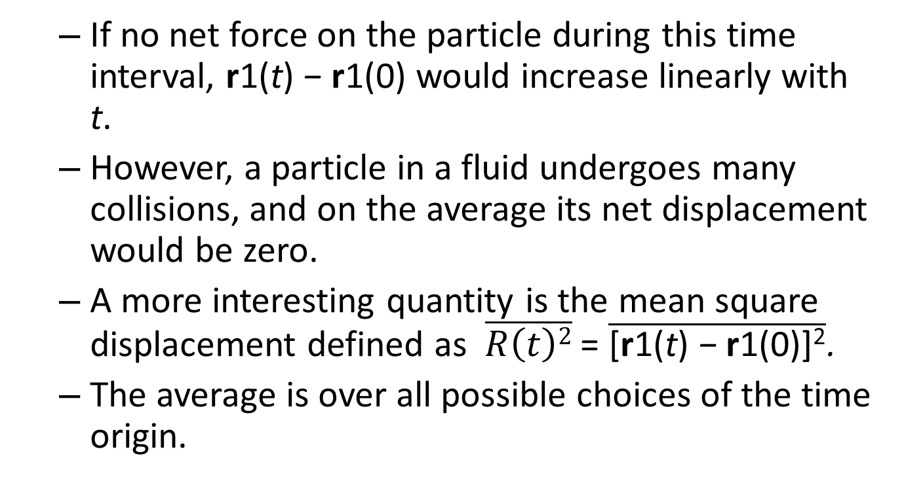
  If no net force on the particle during this time interval, r1(t) − r1(0) would increase linearly with t.
  However, a particle in a fluid undergoes many collisions, and on the average its net displacement would be zero.
  A more interesting quantity is the mean square displacement defined as $\overline{R\left(t\right)2}$ = $\overline{\text{[}\text{r}\text{1(}\text{t}\text{) }\text{− }\text{r}\text{1(0)]}\text{2}}$.
  The average is over all possible choices of the time origin.

Slide 51
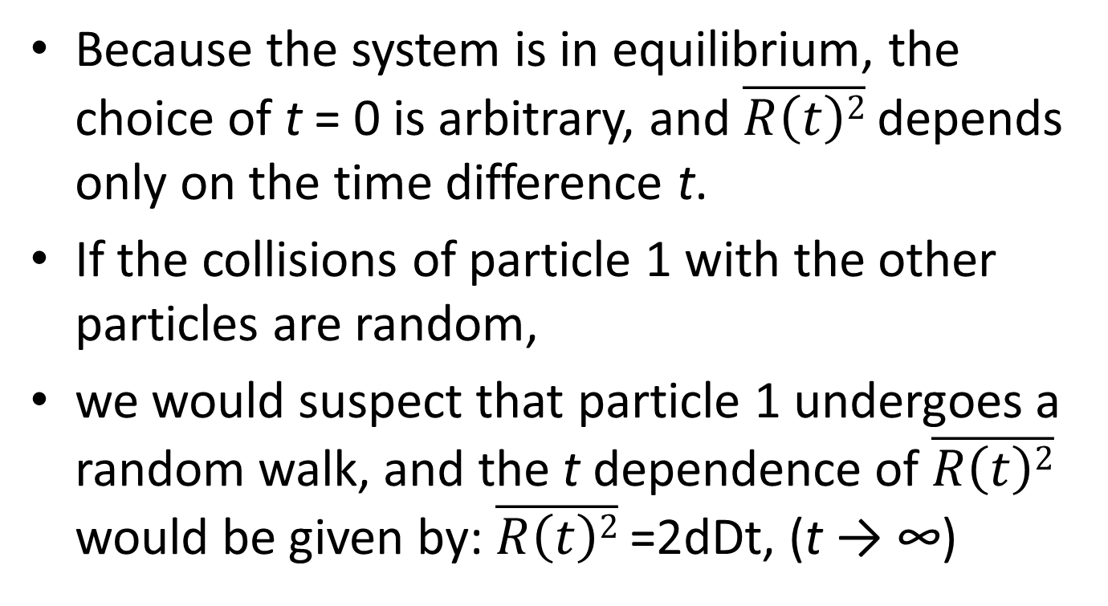
Because the system is in equilibrium, the choice of t = 0 is arbitrary, and $\overline{R\left(t\right)2}$ depends only on the time difference t.
If the collisions of particle 1 with the other particles are random,
we would suspect that particle 1 undergoes a random walk, and the t dependence of $\overline{R\left(t\right)2}$ would be given by: $\overline{R\left(t\right)2}$ =2dDt, (t → ∞)

Slide 52
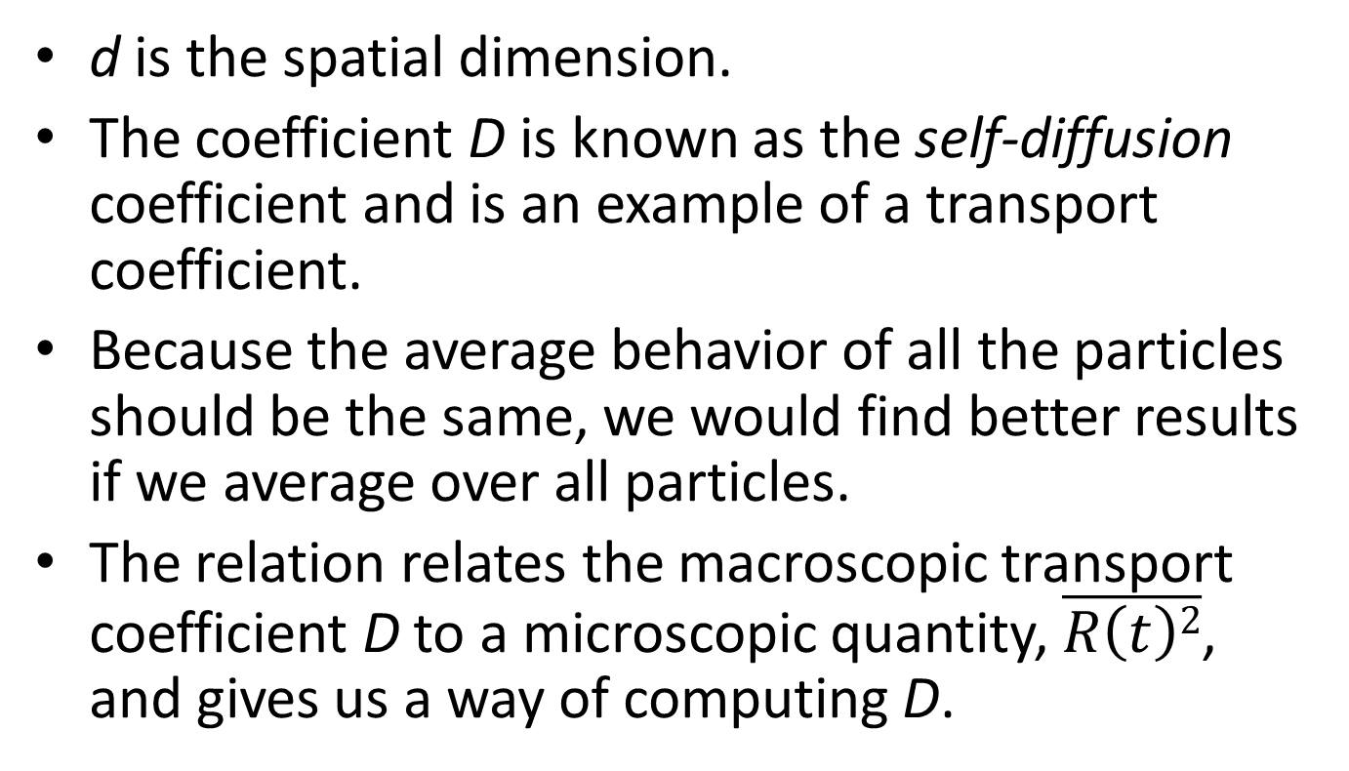
d is the spatial dimension.
The coefficient D is known as the self-diffusion coefficient and is an example of a transport coefficient.
Because the average behavior of all the particles should be the same, we would find better results if we average over all particles.
The relation relates the macroscopic transport coefficient D to a microscopic quantity, $\overline{R\left(t\right)2}$, and gives us a way of computing D.

Slide 53
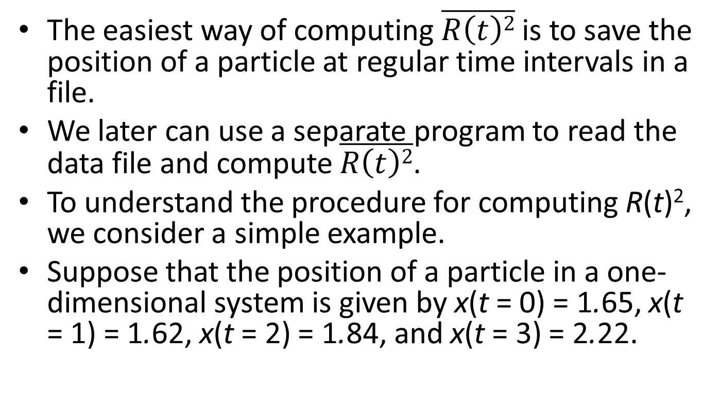
The easiest way of computing $\overline{R\left(t\right)2}$ is to save the position of a particle at regular time intervals in a file.
We later can use a separate program to read the data file and compute $\overline{R\left(t\right)2}$.
To understand the procedure for computing R(t)², we consider a simple example.
Suppose that the position of a particle in a one-dimensional system is given by x(t = 0) = 1.65, x(t = 1) = 1.62, x(t = 2) = 1.84, and x(t = 3) = 2.22.

Slide 54
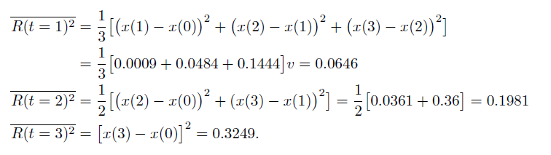
If we average over all possible time origins, we obtain

Slide 55
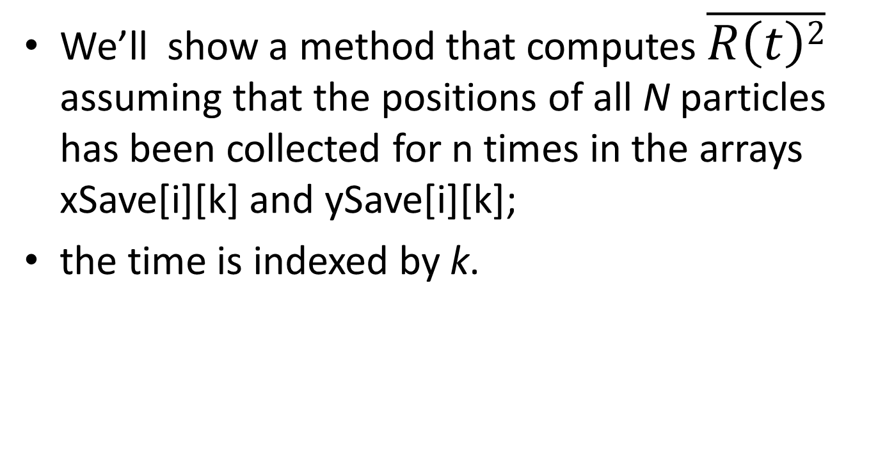
We’ll show a method that computes $\overline{R\left(t\right)2}$ assuming that the positions of all N particles has been collected for n times in the arrays xSave[i][k] and ySave[i][k];
the time is indexed by k.

Slide 56
we cannot find the distance moved by a particle by just keeping track of its position.
  Because of periodic boundary conditions,
  Imagine that a particle moved in only one direction
    and returned to its original position.

Slide 57
If we just subtracted the coordinates of the position,
  we would find that the particle’s displacement was zero
    when in fact it really moved an amount equal to the length of the simulation cell.
How to solve this problem?

Slide 58
To keep track of the movement of each particle, we use two arrays, xWrap and yWrap.
Every time particle i moves past the right boundary in the time interval k*dk to (k+1)*dk, xWrap[i][k] is incremented by Lx.
Similarly, each time the particle moves past the left boundary xWrap[i][k] is decremented by Lx.
A similar procedure is used for yWrap.

Slide 59
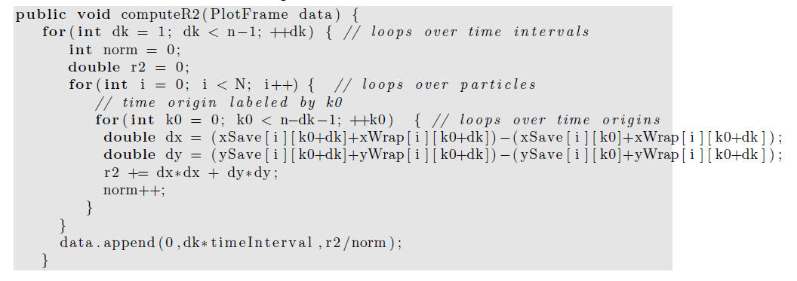
Textbook error!

Slide 60
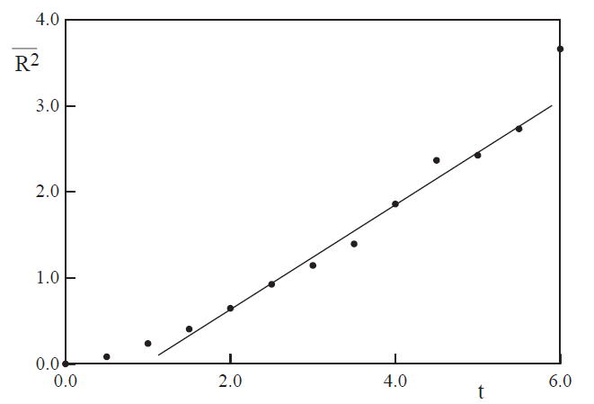
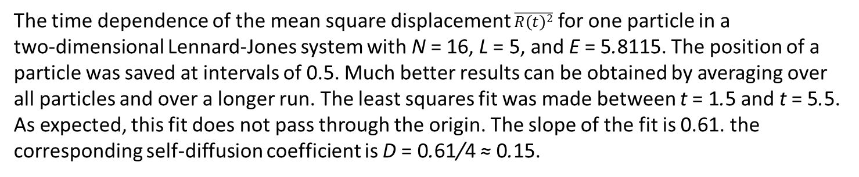
The time dependence of the mean square displacement $\overline{R\left(t\right)2}$ for one particle in a
two-dimensional Lennard-Jones system with N = 16, L = 5, and E = 5.8115. The position of a
particle was saved at intervals of 0.5. Much better results can be obtained by averaging over all particles and over a longer run. The least squares fit was made between t = 1.5 and t = 5.5. As expected, this fit does not pass through the origin. The slope of the fit is 0.61. the
corresponding self-diffusion coefficient is D = 0.61/4 ≈ 0.15.

Slide 61
Another physically important property is the velocity autocorrelation function C(t).
Suppose that particle i has velocity vi at time t = 0.
If there were no net force on particle i, its velocity would remain constant.

Slide 62
However, its interactions with other particles in the fluid will change the particle’s velocity,
and we expect that after several collisions,
its velocity will not be strongly correlated with its velocity at an earlier time.

Slide 63
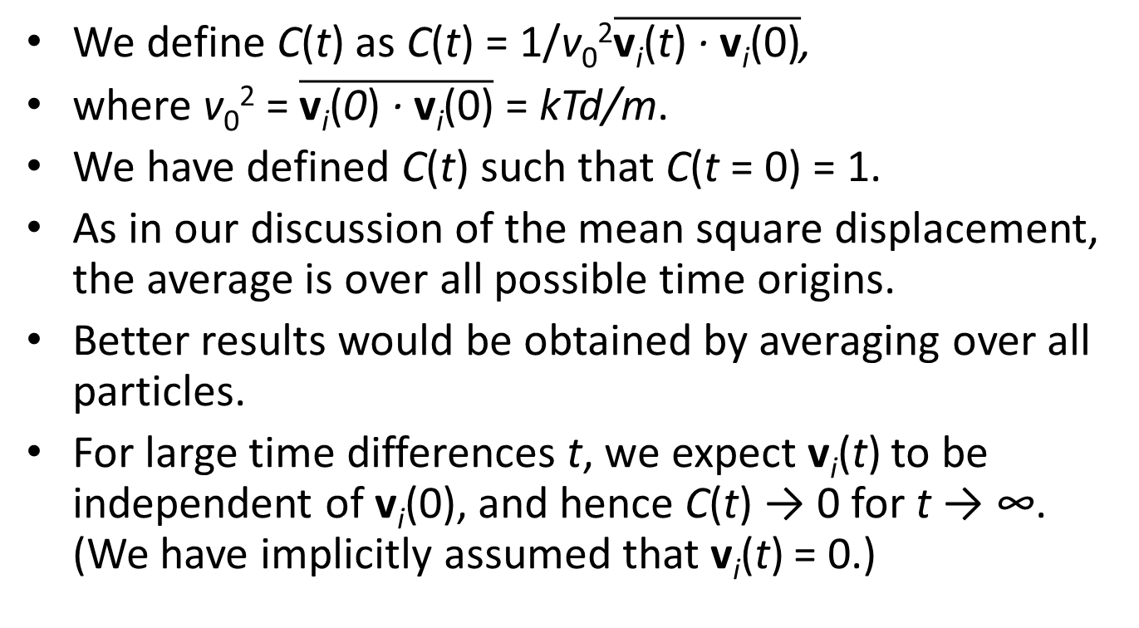
We define C(t) as C(t) = 1/v₀²$\overline{\text{v}\text{i}\text{(}\text{t}\text{) }\text{· }\text{v}\text{i}\text{(0)}}$,
where v₀² = $\overline{\text{v}\text{i}\text{(}\text{0}\text{) }\text{· }\text{v}\text{i}\text{(0)}}$ = kTd/m.
We have defined C(t) such that C(t = 0) = 1.
As in our discussion of the mean square displacement, the average is over all possible time origins.
Better results would be obtained by averaging over all particles.
For large time differences t, we expect v_{i}(t) to be independent of v_{i}(0), and hence C(t) → 0 for t → ∞. (We have implicitly assumed that v_{i}(t) = 0.)

Slide 64
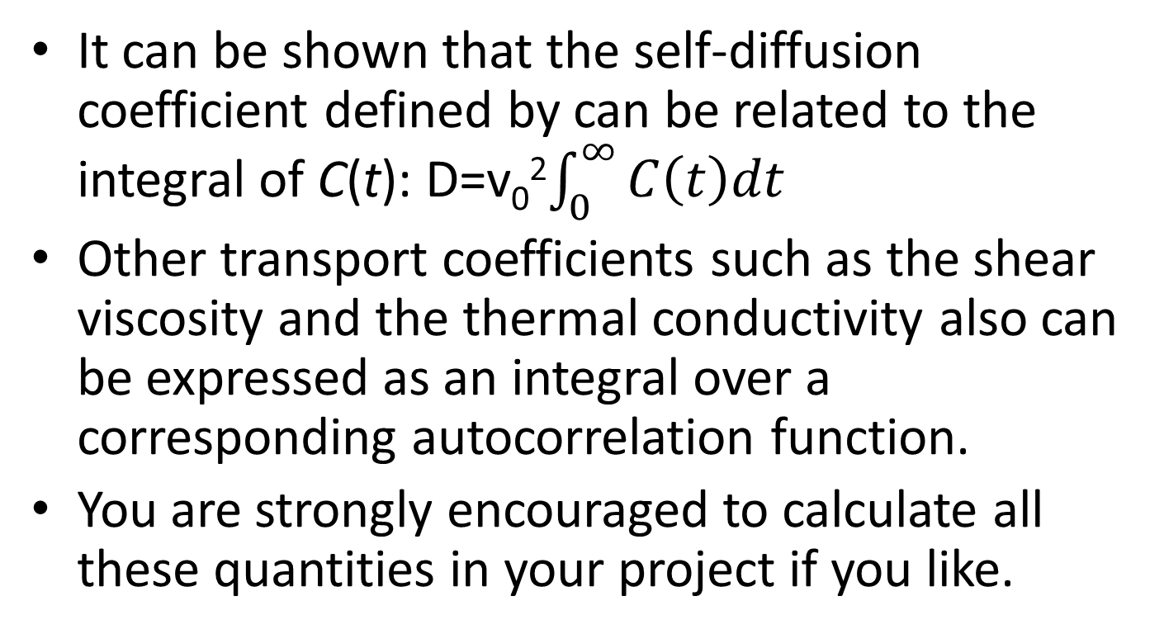
It can be shown that the self-diffusion coefficient defined by can be related to the integral of C(t): D=v₀²$\int_{0}^{∞}{C\left(t\right)dt}$
Other transport coefficients such as the shear viscosity and the thermal conductivity also can be expressed as an integral over a corresponding autocorrelation function.
You are strongly encouraged to calculate all these quantities in your project if you like.

Slide 65
Heat bath
To implement canonical ensemble, we need to fix the temperature.
  Also, such practice can largely reduce the error accumulation in Verlet algorithm.

Slide 66
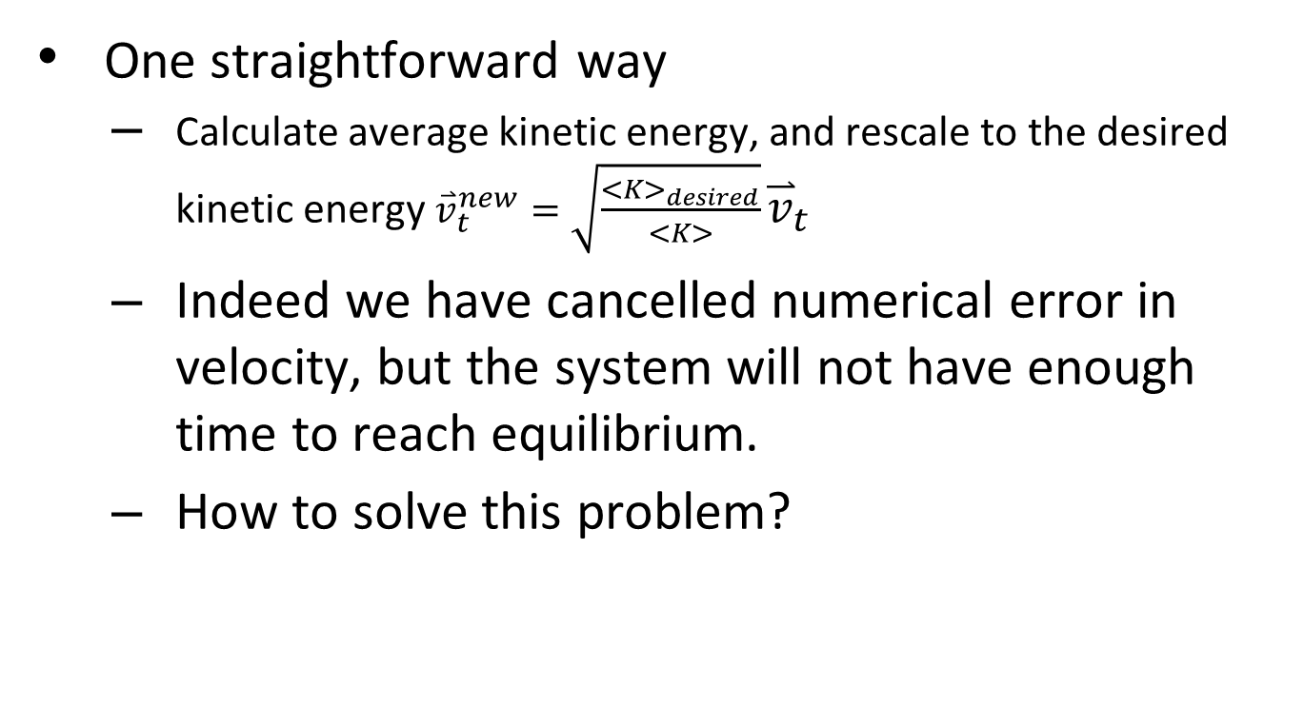
To rescale velocity?
One straightforward way
  Calculate average kinetic energy, and rescale to the desired kinetic energy ${\overset{⃑}{v}}_{t}^{new}=\sqrt{\frac{<K>_{desired}}{<K>}}{\overset{⃑}{v}}_{t}$
  Indeed we have cancelled numerical error in velocity, but the system will not have enough time to reach equilibrium.
  How to solve this problem?

Slide 67
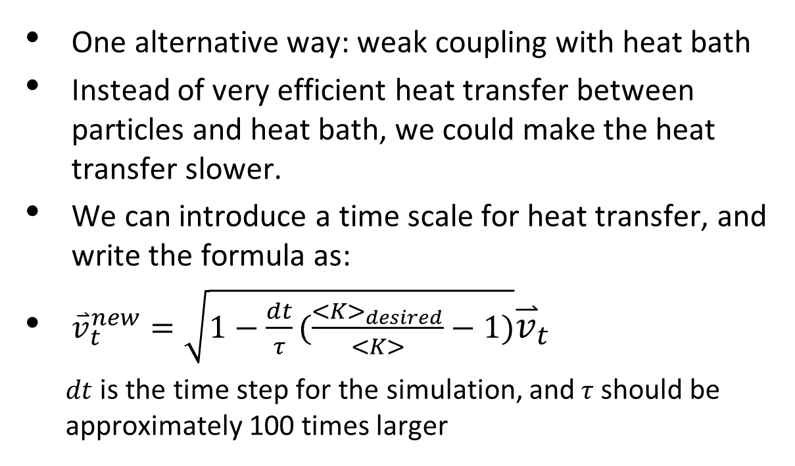
Implementation of heat bath
How to rescale velocity?
One alternative way: weak coupling with heat bath
Instead of very efficient heat transfer between particles and heat bath, we could make the heat transfer slower.
We can introduce a time scale for heat transfer, and write the formula as:
${\overset{⃑}{v}}_{t}^{new}=\sqrt{1−\frac{dt}{τ}(\frac{<K>_{desired}}{<K>}−1)}{\overset{⃑}{v}}_{t}$
  $dt$ is the time step for the simulation, and$τ$ should be approximately 100 times larger

